Slide 1
LENDING CLUB CASE STUDY SUBMISSION
Names
Pramod Yadav
Avishek Sen Gupta

Slide 2
Lending Club
Introduction
The Lending Club is a consumer finance company which specialises in lending various types of loans to urban customers. When the company receives a loan application, the company has to make a decision for loan approval based on the applicant’s profile. Two types of risks are associated with the bank’s decision:
If the applicant is likely to repay the loan, then not approving the loan results in a loss of business to the company
If the applicant is not likely to repay the loan, i.e. he/she is likely to default, then approving the loan may lead to a financial loss for the company
Business Understanding and Domain
Like most other lending companies, lending loans to ‘risky’ applicants is the largest source of financial loss (called credit loss).
The credit loss is the amount of money lost by the lender when the borrower refuses to pay or runs away with the money owed. In other words, borrowers who default cause the largest amount of loss to the lenders. In this case, the customers labelled as 'charged-off' are the 'defaulters'.
Objective
The company wants to understand the driving factors (or driver variables) behind loan default, i.e. the variables which are strong indicators of default. The company can utilise this knowledge for its portfolio and risk assessment.

Slide 3
Problem Solving Workflow
View Columns
Write consistency tests between data sets
Analyse malformed data patterns
Run cleanup scripts
Run consistency tests between data sets
Build master data
Filter based on problem criteria
Analyse
Refactor
Generate Jupyter Notebook

Slide 4
Data Understanding: CRISP-DM #2
Data understanding was achieved in several ways:
A data dictionary was provided, which contained explanations for all the columns that are present in the original loans data set. This also directly helped in understanding what the valid values were in a particular columns, and later helped in the Data Preparation step.
There was a specific session which was conducted where information about these columns were clarified to a further degree, eg: the ranking of the loan grades, etc.
A basic understanding of the loan industry also helped in doing exploratory data analysis based on some initial intuition, eg: loan amount could be relevant to determining the possibility of default, etc.
The analysis is mostly focused on Exploratory Data Analysis, and some conclusions have been made, and some advice suggested. However, more rigorous hypothesis testing as well as potential data transformations (on data which could be normal but is skewed) need to be made before drawing definitive conclusions around Driver Variables.

Slide 5
Data Preparation: CRISP-DM #3
This is a summary of the steps we have taken to clean the data:
Checking the null values across the column and row.
Dropped the column which have 100% missing values. 54 columns have missing values such as annual_inc_joint,tot_coll_amt
Dropping column which have more than 60% of missing values
Checking the duplicate rows in the data
Dropping columns which have constant values Such as: pymnt_plan,initial_list_status
Dropping customer behaviour columns which we will not have initially while granting the loan Such as:last_pymnt_d,application_type
Checking highly correlated columns which we can drop such as : funded_amnt,funded_amnt_inv
Dropping rows which aren’t helpful for analysis like “Current” in loan_status, because they contain data that would not be useful for inference or prediction.
Correcting data types of columns such as: int_rate,emp_length
Creating derived columns:
Created Year and Months Column from Date_of_Issue
Interest rate Category from Interest Rate Column

Slide 6
Data Analysis
Exploratory Data Analysis was divided into the following categories:
Univariate Analysis: Checking Distribution and Frequencies of data
Segmented Univariate Analysis: Segmenting the data as per loan_status column and performing univariate analysis
Bivariate Analysis : Using 2 columns at a time to see the relationship among the variables.

Slide 7
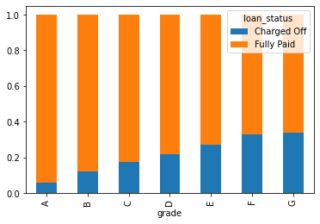
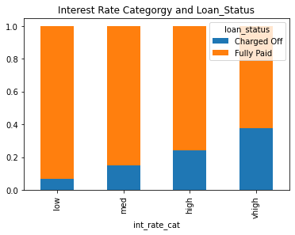
Findings
Lower grades imply a higher percentage of default
A higher interest rate implies a higher percentage of default.

Slide 8
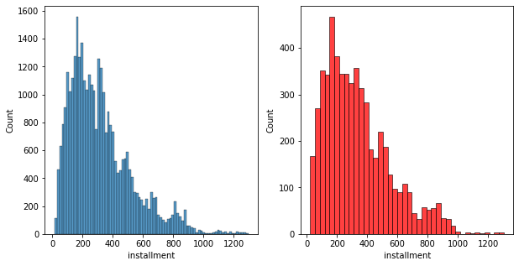
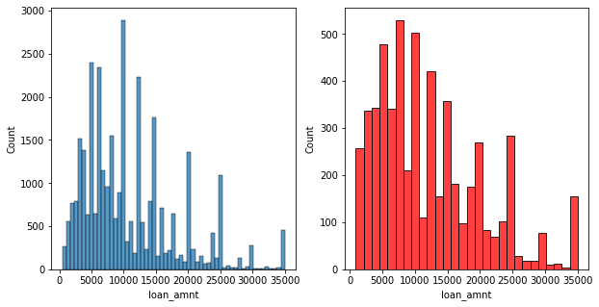
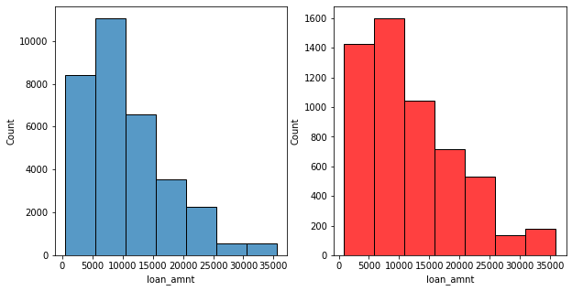
Findings
For Defaulters, the installment size distribution is right skewed with a peak of around 160, indicating that lower-valued loans around $160 are more likely to default.
There are interesting spikes when plotting counts by loan amounts, at 5000, 10000, 12500, 15000. This suggests people usually borrow at these amounts. Taking a larger bin width of 5000 smoothes the histogram, and gives us a similar right skewed distribution for Defaulters.

Slide 9
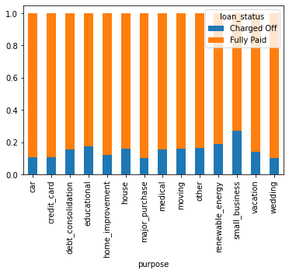
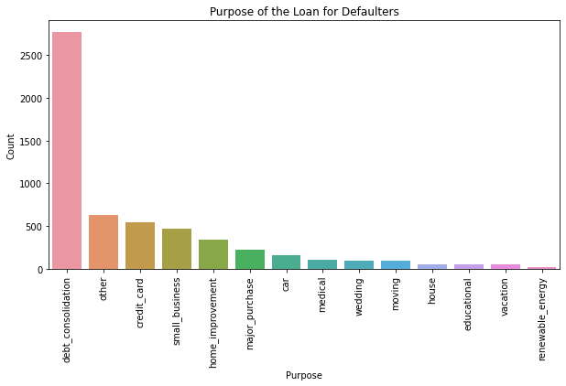
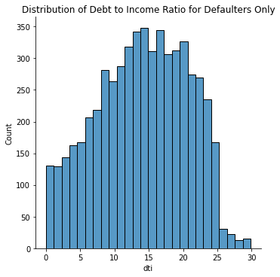
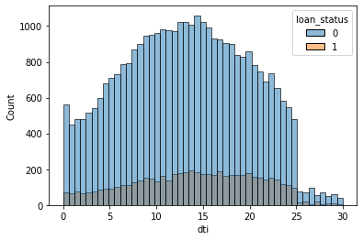
Findings
No specific trend in default percentages noted based on loan purpose. However, among Defaulters, a large percentage state debt_consolidation as the purpose of the loan.
Debt-to-Income Ratio is somewhat normally distributed across Defaulters with a possible left skew. Median DTI for both Defaulters and Non-Defaulters is around 15.

Slide 10
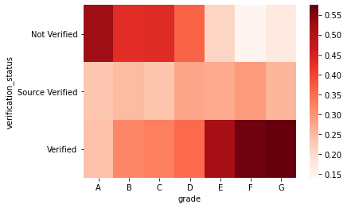
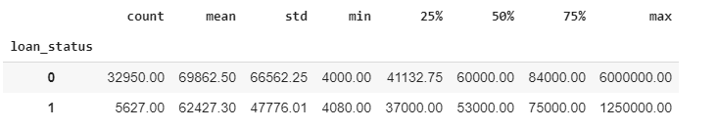
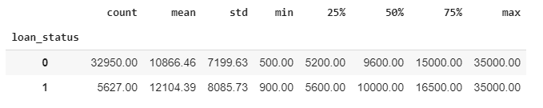
Findings
Verification Status Heatmap: Possibility of Default when using Third Party as verification indicates a higher chance of loan repayment.
Annual Income and Loan Amount:
Defaulters earn less median income and request slightly higher loan amounts, than non-Defaulters.

Slide 11
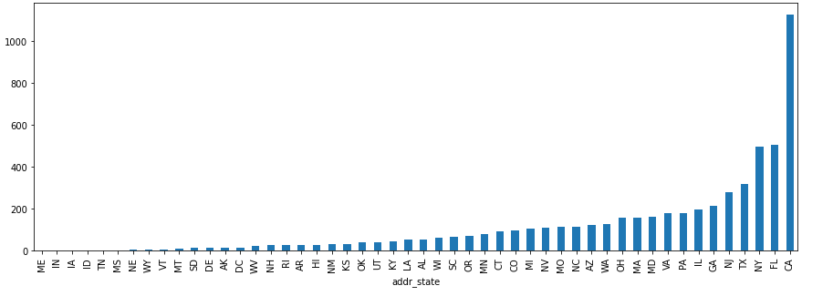
Findings
Defaulters originate mostly from:
California
Florida
New York

Slide 12
Conclusions and Advice
Key Drivers:
Loan Grade / Sub-Grade: Lower grades (G is the lowest) imply a higher percentage of defaulters.
Interest Rate: A higher interest rate implies a higher percentage of defaulters.
Installment Amount: The defaulters are normally distributed with a right skew across Installment Amounts. With a proper data transformation, the distribution can be made normal.
Loan Amount: The defaulters are normally distributed with a right skew across Loan Amounts. With a proper data transformation, the distribution can be made normal.
Loan Purpose: The most frequent purpose of loan cited is “debt_repayment” for Defaulters.
Debt-to-Income Ratio: The defaulters are normally distributed across Debt-to-Income Ratio.
Verification Status: Using a Third Party for verifying income source (Source Verified) seems to give a better repayment rate (lower default) across all grades of loans.
Annual Income and Loan Amount: Defaulters earn less median income and request slightly higher loan amounts, than non-Defaulters.
State: Defaulters originate mostly from California (high proportion), Florida, and New York.

